Slide 1
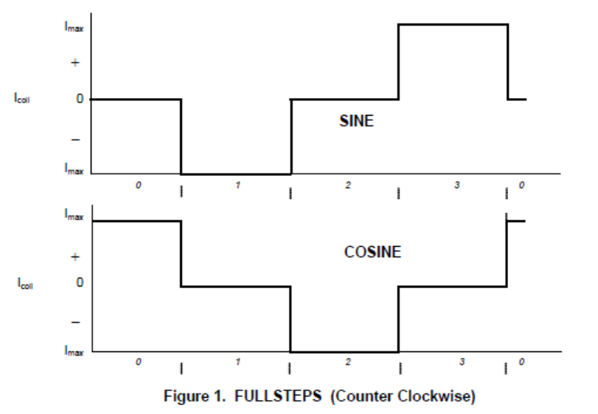
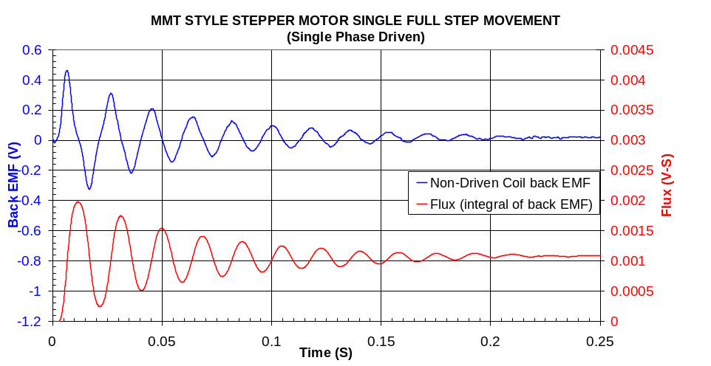
Open Coil Voltage (Moving Motor)
0.6V
-V(bemf_A)
0.4V
0.2V
0.0V
-0.2V
-0.4V
-0.6V
-0.8V
-1.0V
-1.2V
125ms
175ms
225ms
275ms
325ms
375ms
Green waveform: Spice model prediction
Blue waveform: Actual measured back-EMF

